Slide 1
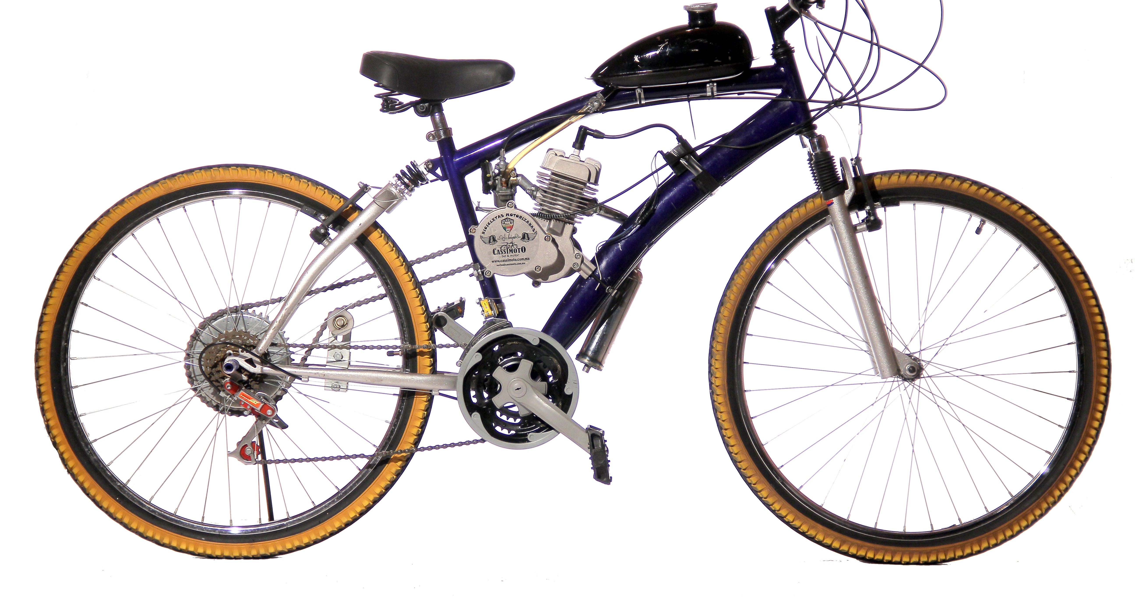
Cyclistic
BIKE-SHARE
NAVIGATING SPEEDY SUCCESS
By: Michael Essiful

Slide 2
Business Task
Analyze cyclistic hististorical bike trip data for 2024 to understand how annual members and casual riders uses bikes differently.
Use insights to design marketing strategies for converting casual riders into annual members.
Key Questions
How do annual members and casual riders use cyclistic bikes differently?
Why would casual riders buy annual membership?
How can cyclistic use digital media to influence casual riders to become members?

Slide 3

Data Source
Cyclistic Historical Trip Data
https://divvy-tripdata.s3.amazonaws.com/index.htmlhttps://divvy-tripdata.s3.amazonaws.com/index.html
This Photo by Unknown Author is licensed under CC BY-SA

Slide 4

Data
Cleaning Steps
Downloaded/unzipped 12 monthly CSVs; stored in dedicated folder with backups.
Imported into excel; removed duplicates and null entries.
Created helper columns
  Ride duration
  Ride start hour
  Ride date
  Ride day
  Binned durations: 0-10; 11 – 20; 21 – 30; 31 – 40; 41 – 50; and above 60
  Counted rows to determine total rides
  Saved all into external data connection
  Loaded into one master sheet for analysis (5.67M rows)
This Photo by Unknown Author is licensed under CC BY-NC

Slide 5
Key Insights
Seasonal Trends: Rides peak in summer (Jun-Aug)
User Differences: Members: Shorter, consistent rides (commuters, weekdays); prefer classic bikes. • Casuals: Longer, recreational rides (weekends/summer); favor electric/docked for leisure.
Duration Patterns: Most rides <20 min (78%); casuals average ~28 min vs. members ~14 min.
Time of Day: Bimodal peaks (7–9 AM, 4–6 PM) – commute hours; casuals more midday.
Ride Types: Classic bikes dominate; electric surges in warm months.

Slide 6
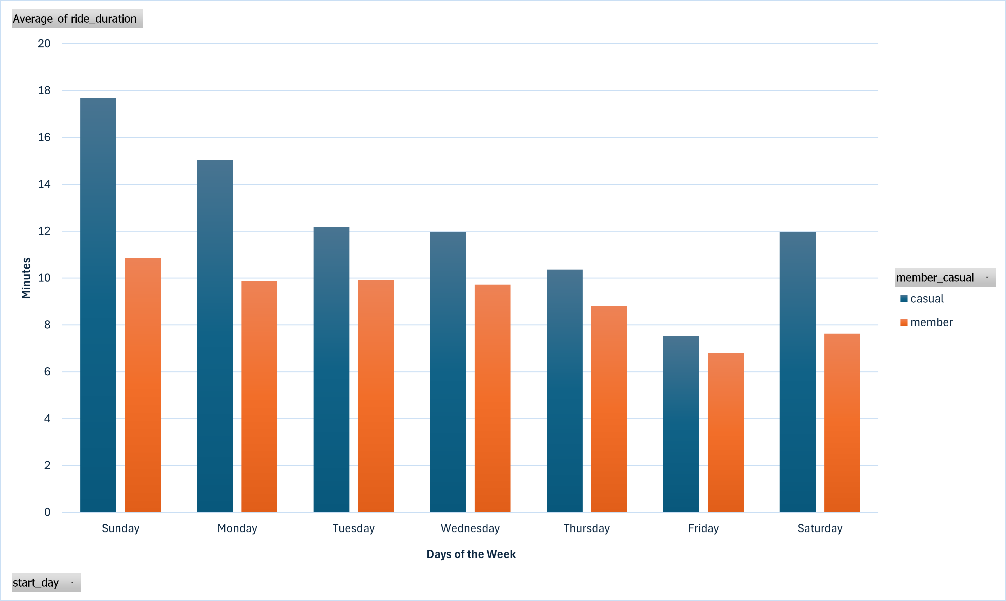
Average Rides Duration by Day

Slide 7
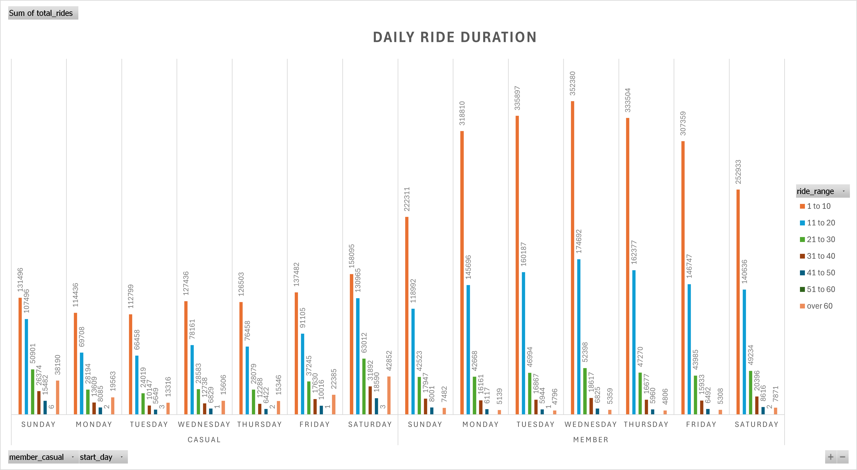
Duration Paterns

Slide 8
Key Insights:
Average Rides per day and Duration
Description: Grouped bar chart comparing average duration (y-axis: 0-20 min) for members (blue) vs. casuals (orange) across days (x-axis: Sun-Sat).
Key Findings:
• Casuals average 2x longer rides than members on weekends (Sun: 18 min casual vs. 10 min member; Sat: 16 min vs. 9 min).
• Members maintain steady ~12-14 min rides weekdays (Mon-Fri), dropping slightly on weekends (~10 min).
• Overall weekly average: Casuals ~15 min, members ~12 min; highest casual durations on Sun/Tue (18 min).
• Gap widens on non-workdays, suggesting casuals use for leisure/exploration/tourism.
Conversion Tie-In: Weekend spikes show casuals as “occasional explorers”; launch weekend-only membership discounts to encourage habitual use.

Slide 9
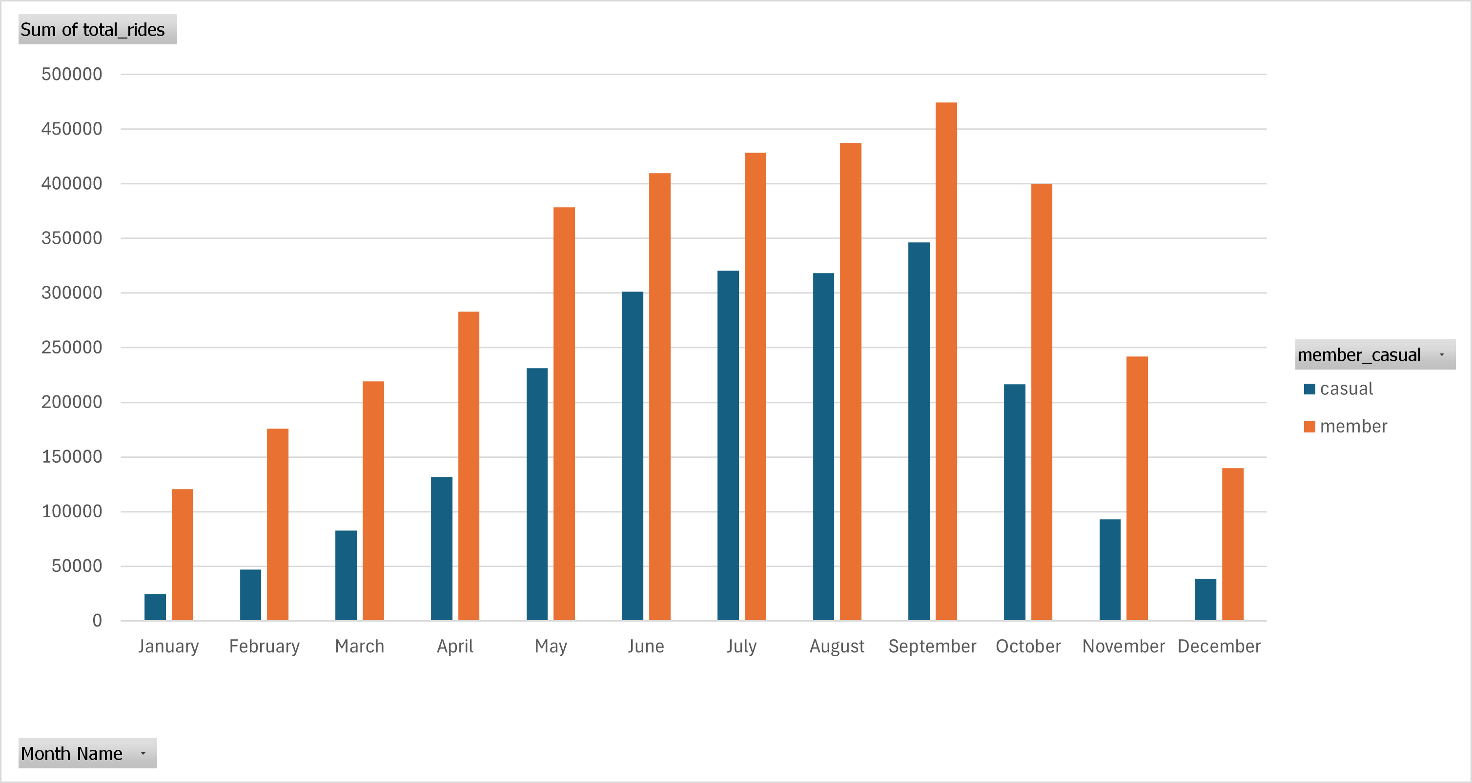
Seasonal Trends

Slide 10
Key Insights:
Seasonal Trends
Description: Clustered columns for members (blue) vs. casuals (orange) per month (x-axis: Jan-Dec; y-axis: 0-50,000 rides).
Key Findings:
Members are consistent (~20,000-30,000 rides/month year-round), making up ~60-70% of total volume.
Casuals spike dramatically in summer (Jun-Aug: ~40,000-45,000 rides, 40% of total), but drop to <10,000 in winter.
Annual total: ~3.2M member rides vs. ~2.5M casual; summer accounts for 50% of casual growth.
Ratio shifts: Winter 80/20 member/casual; summer 50/50.
Conversion Tie-In: Seasonal casual surge indicates weather-motivated users; use geofenced summer ads near stations to convert “fair-weather” riders.

Slide 11
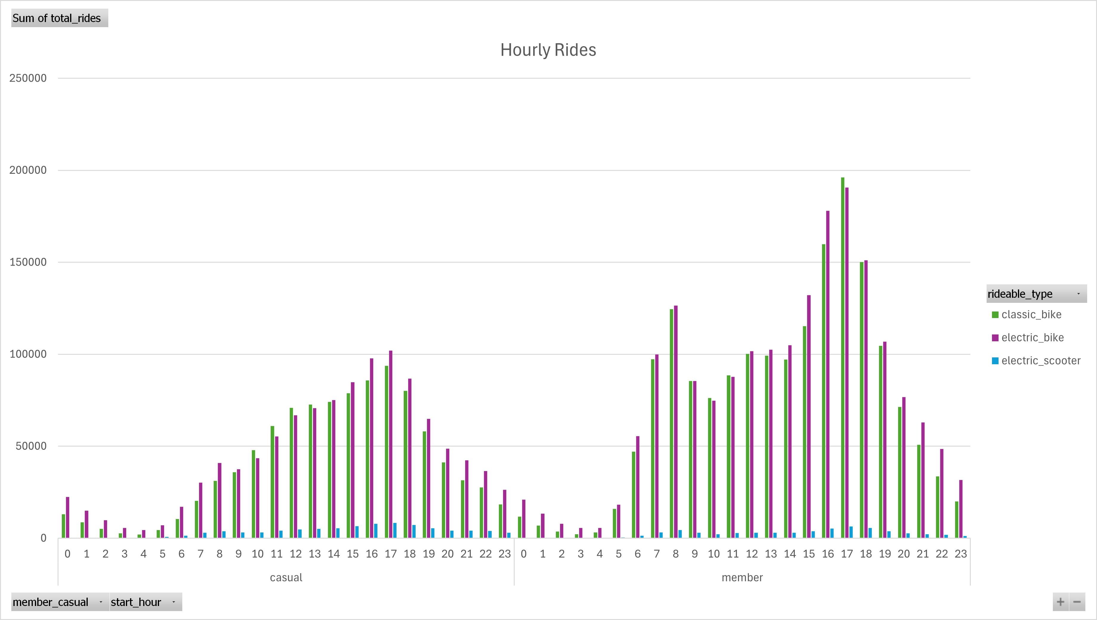
Time of Day Patterns

Slide 12
Key Insights:
Hourly Breakdown
Description:
A vertical bar chart showing total rides per hour of the day (x-axis: 0-23 hours; y-axis: 0-50,000+ rides). Data is aggregated from PivotTable, with a bimodal pattern.
Key Findings:
Peak usage occurs during commute hours: ~7-9 AM (morning rush) and ~4-6 PM (evening rush), with ~45,000-50,000 rides each.
Low activity overnight (12-5 AM: <5,000 rides) and midday (10 AM-3 PM: ~10,000-20,000).
Overall, 70% of rides happen between 6 AM-10 PM, indicating urban mobility patterns.
Conversion Tie-In: Casuals may use bikes sporadically for leisure; target them with ads during off-peak hours (e.g., midday) emphasizing unlimited access for flexible lifestyles.

Slide 13
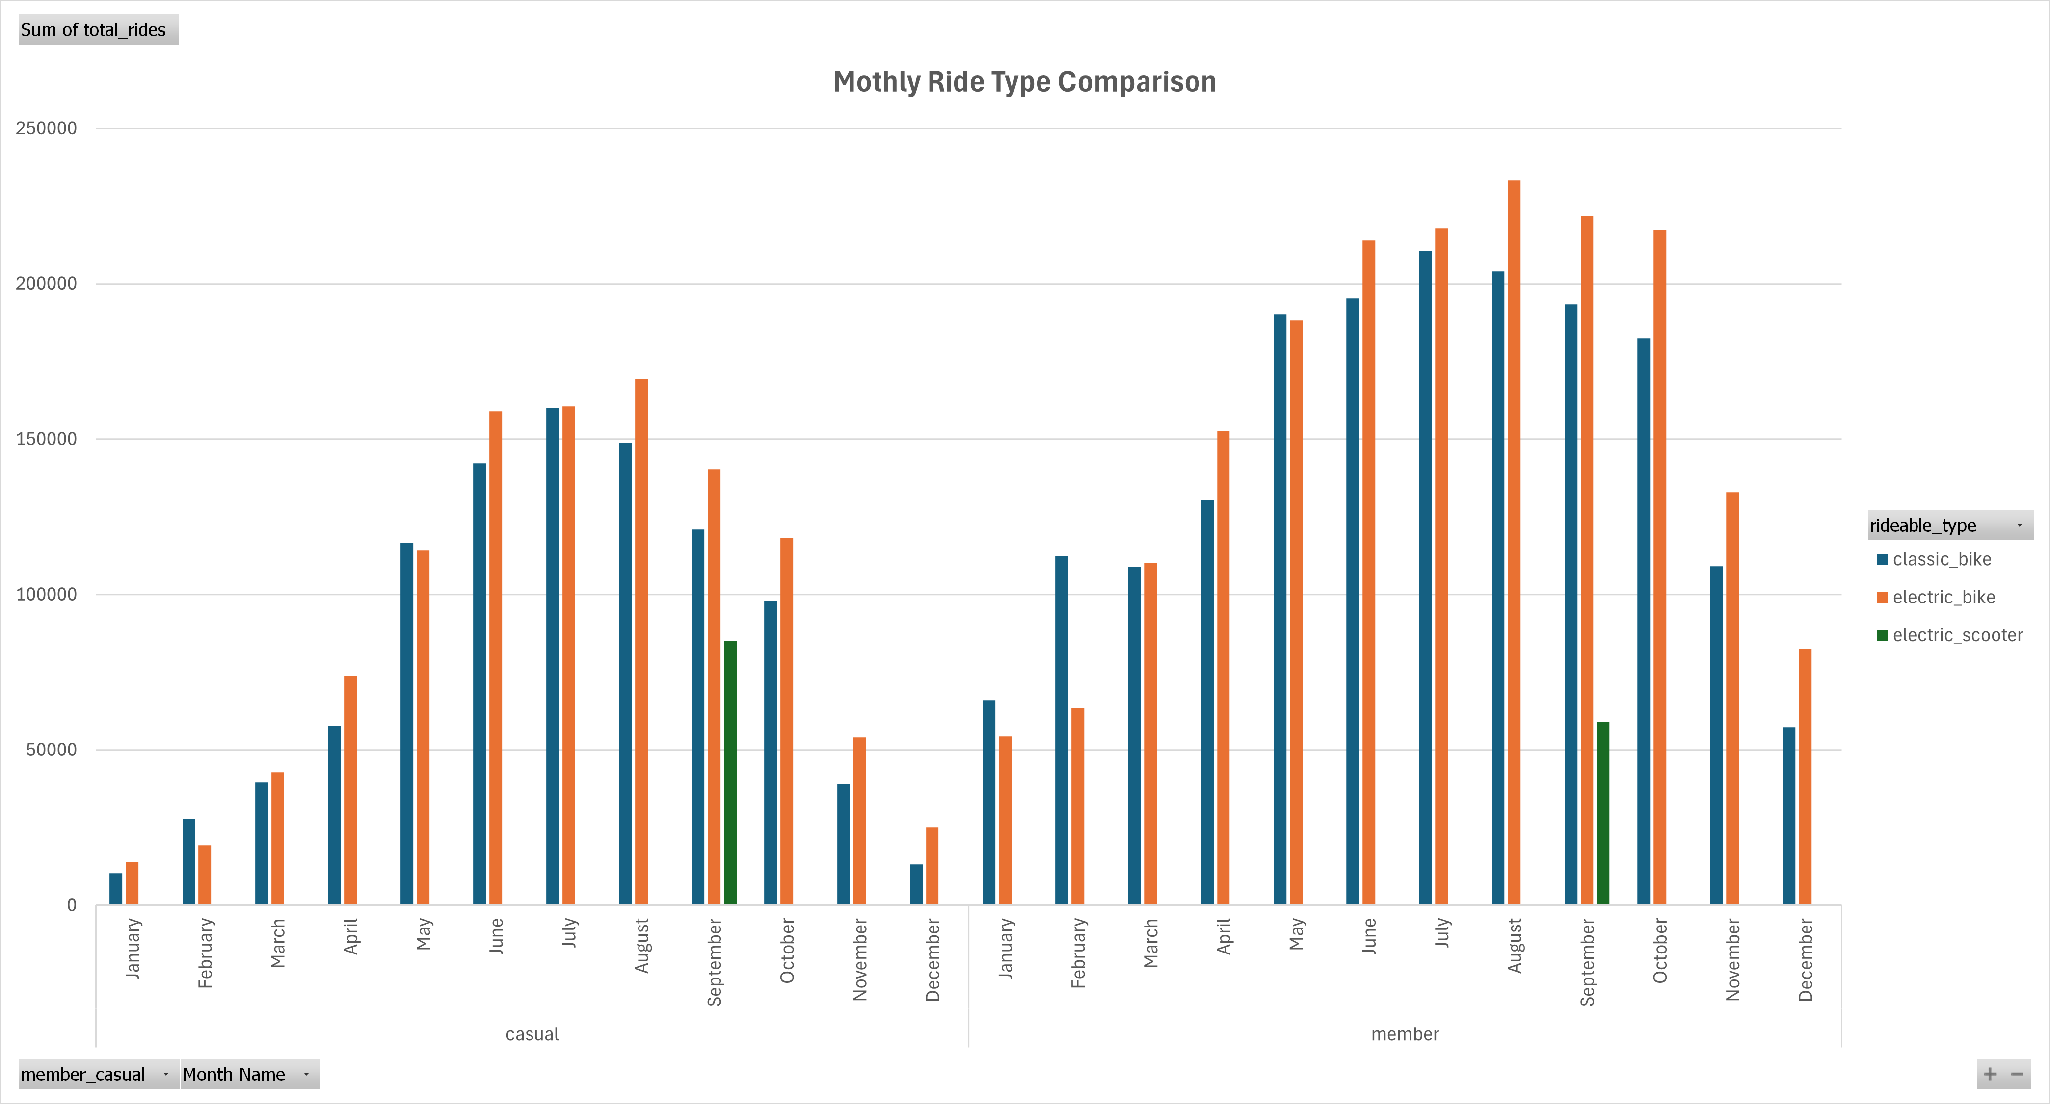
Ride Type

Slide 14
Key Insights:
Ride Type
Description:
Clustered columns for three ride types (classic: blue, electric: orange, docked: green) across 12 months (x-axis: Jan-Dec; y-axis: 0-30,000 rides). Grand total per month shown.
Key Findings:
Classic bikes dominate year-round (~70% of rides), peaking in summer (Jun-Aug: ~25,000-30,000 rides/month).
Electric bikes surge in warmer months (Jun-Aug: ~15,000-20,000 rides), dropping to <5,000 in winter (Jan-Feb).
Docked bikes are minimal (<2,000/month), suggesting low demand for assistive options (aligns with case study: only 8% use).
Total rides increase 2-3x in summer vs. winter, driven by weather/leisure.
Conversion Tie-In: Casuals favor electric for fun rides; offer membership trials with electric priority docking to hook seasonal users.

Slide 15
WAYS TO CONVERT CASUAL RIDERS TO MEMBERS
Based on these findings, here are targeted, data-backed strategies (aligned with Lily Moreno’s digital media focus):
Seasonal “Summer Switch” Campaign: Launch Jun-Aug via Instagram/Facebook/TikTok/X ads geofenced to Chicago stations. Highlight savings on long electric rides (e.g., “Unlimited summer adventures for $99—save 70% vs. daily passes”). Offer a free trial month; track via app sign-ups. Expected Impact: Capture 30% of casual spike.
Weekend Warrior Perks: Email/SMS blasts to casual app users on Fri-Sun, promoting “Weekend Unlimited” (no overage fees for >30 min rides). Bundle with electric bike priority. Use retargeting for past weekend riders. Expected Impact: Convert leisure users by addressing high weekend costs.

Slide 16
WAYS TO CONVERT CASUAL RIDERS TO MEMBERS
Commute Teaser Ads: Push notifications during peaks (7-9 AM/4-6 PM) via Google Display/YouTube: “Ditch traffic—join for unlimited short commutes.” A/B test with casuals who’ve done 5+ short rides. Include referral bonuses for sharing. Expected Impact: Bridge casuals’ sporadic use to daily habits.
Weekend Warrior Perks: Email/SMS blasts to casual app users on Fri-Sun, promoting “Weekend Unlimited” (no overage fees for >30 min rides). Bundle with electric bike priority. Use retargeting for past weekend riders. Expected Impact: Convert leisure users by addressing high weekend costs.
Personalized Digital Nudges (Cross-Graph): Use app data for tailored emails (e.g., “You’ve ridden 45 min this weekend—membership saves you $20 next time”). Integrate with social proof (e.g., “Join 70% of riders for year-round access”). Measure via conversion tracking.
Cyclistic casual riders take significantly longer rides (averaging 16–18 minutes) than members (10–12 minutes), especially on weekends, while members maintain consistent short trips for commuting. Total rides surge in summer (June–August), with casuals driving the spike and outpacing members, alongside a strong preference for electric bikes during warm months. Most rides last under 20 minutes, but casuals dominate longer durations (>30 minutes), particularly on weekends and in summer. To convert casuals, target their seasonal and leisure patterns with (a price) “Chicago Summer Pass” offering unlimited rides and electric priority, promoted via tourist hubs and digital ads to capture high-value summer visitors.

Slide 17
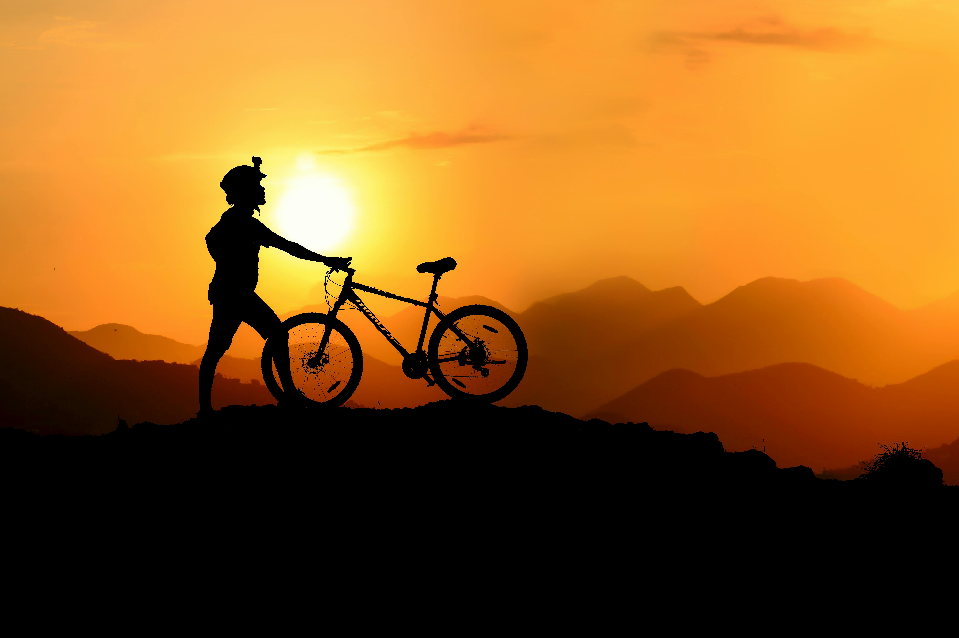
These strategies leverage digital channels for low-cost, high-reach targeting, aiming for 15-25% casual-to-member conversion in Year 1.

